Slide 1

Discovering Opportunities for a Coffee Roasting Company

Slide 2
TNV Roasters:
Brand new coffee roasting company
About to launch its first store in New York, USA
Based on data from another coffee roaster in the city (Maven Roasters), this analysis aims to help our company make decisions about:
The location of our first store
Optimizing daily employee shifts
Product Selection and Pricing
*The dataset covers the period from January to June 2023
Source: https://www.kaggle.com/datasets/ahmedabbas757/coffee-sales/data

Slide 3
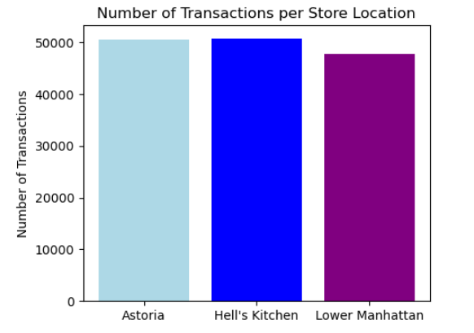
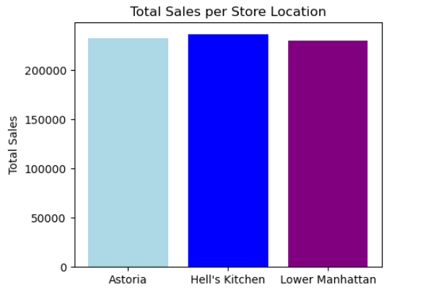
Location analysis of Maven Roasters' stores

Slide 4
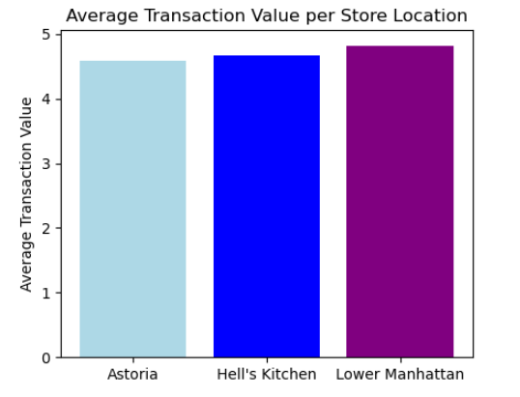
Location analysis of Maven Roasters' stores
The location does not appear to be related to sales of Maven Roasters’ three stores
For the selection of the location of our first store, it is suggested to take into account other factors such as rent levels in the area, accessibility, etc.

Slide 5
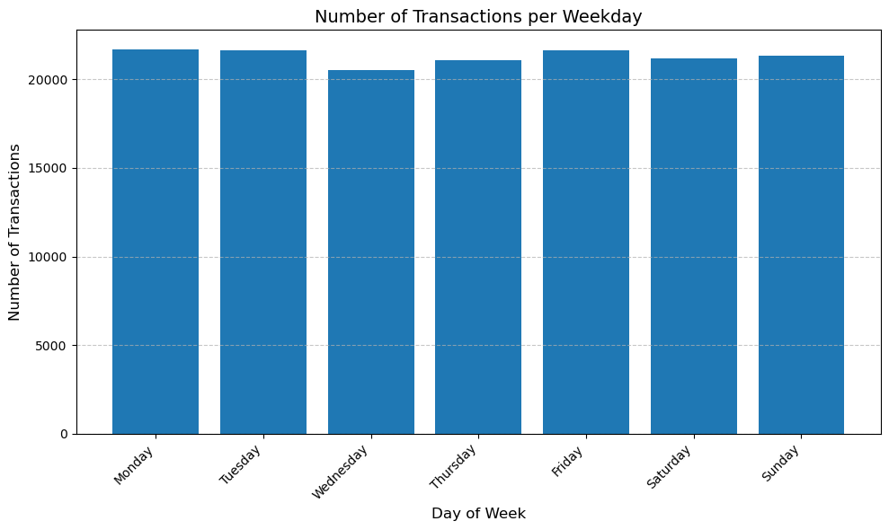
Weekly Sales Distribution
This plot illustrates the total number of transactions on each weekday, providing valuable insights into the weekly sales distribution.

Slide 6
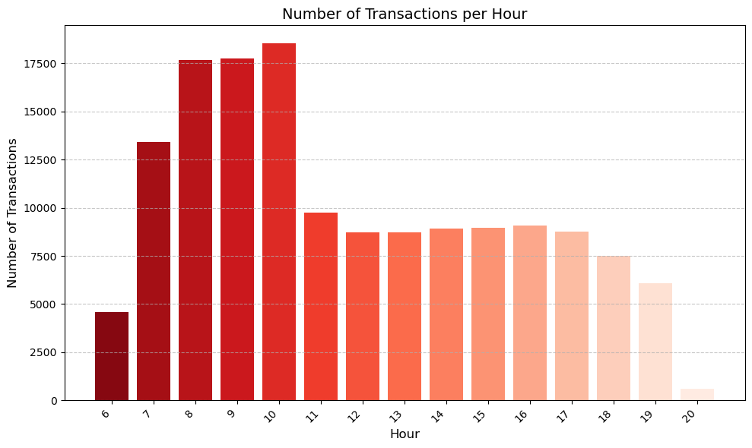
Daily Sales Distribution
This bar chart showcases the total number of transactions during each hour of the day, helping us identify peak sales hours.

Slide 7
Product Selection and Pricing
Total Sales Per Category
Average Price Per Category
Product Selection

Slide 8
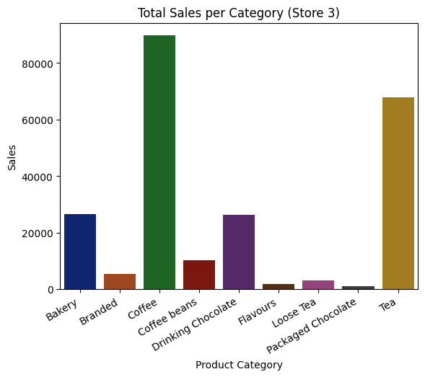
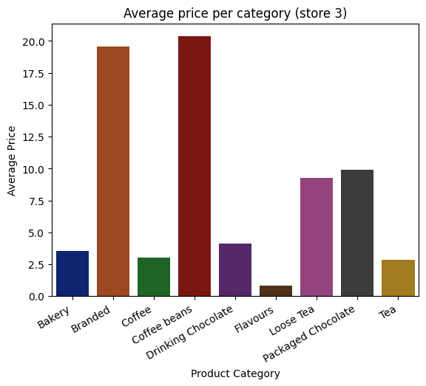
Astoria Store

Slide 9
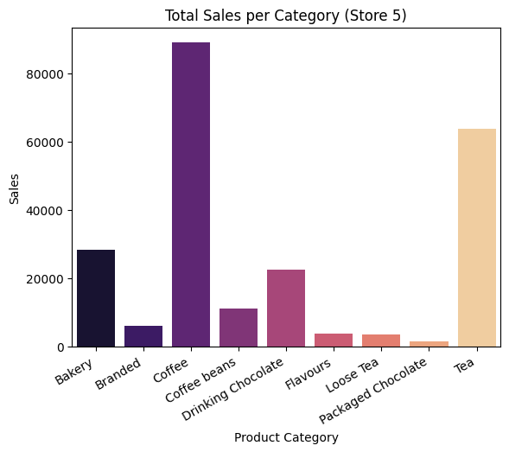
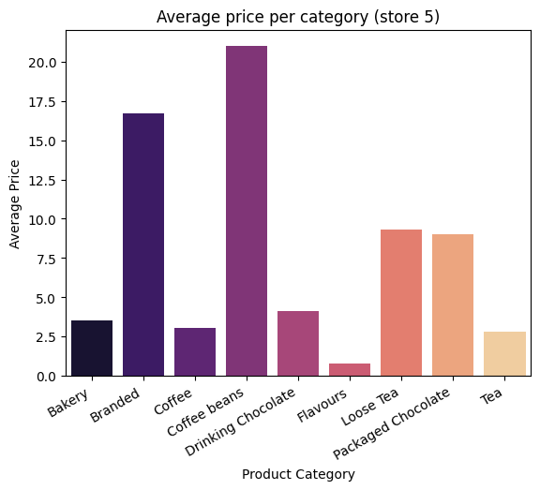
Lower Manhattan Store

Slide 10
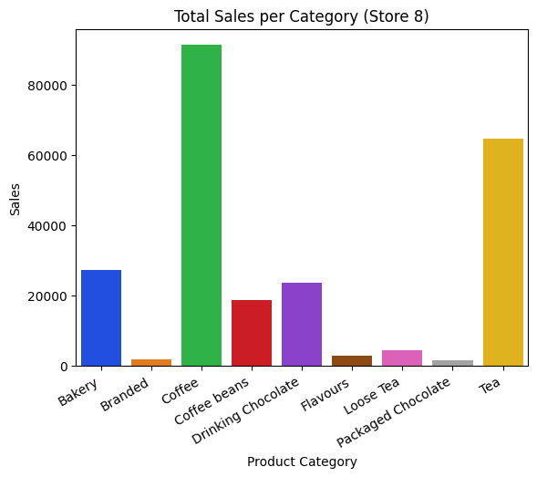
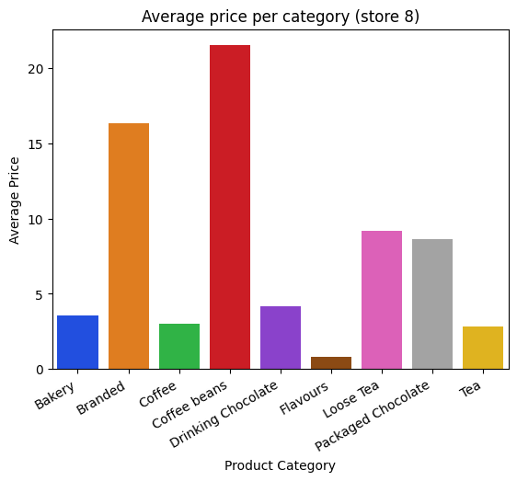
Hell’s Kitchen Store

Slide 11
Initial Product Categories:
Bakery
Coffee
Drinking Chocolate
Tea

Slide 12
Thank you!

